Slide 1





UNPACKING THE GREAT RESIGNATION
Reyada Atanasio
Maryama Diaw
Alexis Fennoy
O. Justina Molokwu
Tabitha Mundia
Examining Key Drivers of
Attrition Across U.S. Industries

Slide 2



REALITY OF THE GREAT RESIGNATION
COVID-19 has driven unprecedented shifts in what work looks like, how work gets done and the working standards that employees expect from their employers.
On average, 3.98M workers quit their jobs each month of 2021.
Since spring 2021, 33M Americans quit their jobs.
30 – 45 year olds have the highest resignation rates.
Notes:
Transition to stats - although we’ve all heard anecdotes, what are the actual numbers?
33M Americans quit their jobs since Spring 2021 (compared with the roughly 161 million people in the workforce last year)
3.98M workers on average quit their jobs each month in 2021
30-45 yos highest resignation rates
Notes from Project Description:
The numbers for employee attrition in the midst of the pandemic are rising at an alarming rate. This phenomenon, which is largely being referred to as “The Great Resignation”, is gaining momentum and this has created a major dilemma for U.S. organizations. The culture of work in the U.S. is seeing a major shift, therefore the goals and organizational imperatives of most U.S. firms have shifted dramatically in order to try to account for the new needs of American workers. Given the ultimate goal for these organizations being the retention of the quality employees they are recruiting, the focus of our project will be to analyze how the retention and attrition rates by state could be related to prevalent factors (i.e., salaries and wages, availability of remote options, child care needs and costs, health care benefits, etc.) that affect work in those states.
Notes from Datafolio:
Since the onset of the COVID-19 pandemic, the U.S. workforce has seen unprecedented shifts in what work looks like, how work gets done and the working conditions that employees will (or will not) tolerate from their employers. In July 2021, there were a record breaking 10.9 million open jobs within the U.S. workforce. In August 2021, 4.3 million Americans quit their jobs. This only added to the number of vacancies plaguing the current job market and is not in line with the work trends we would expect in such a major period of uncertainty

Slide 3

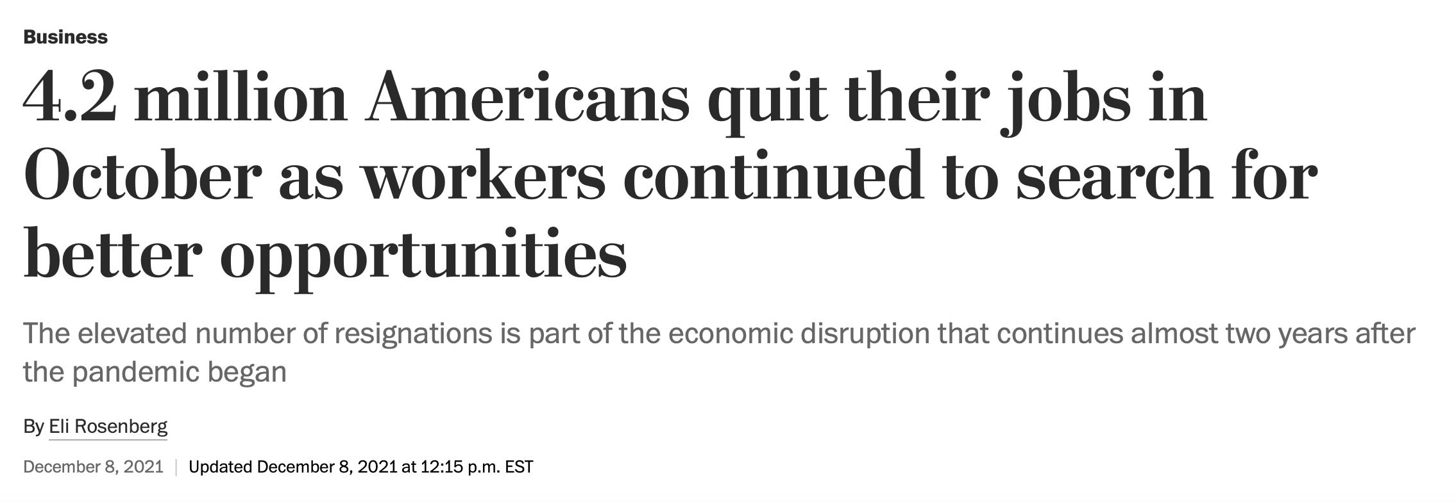


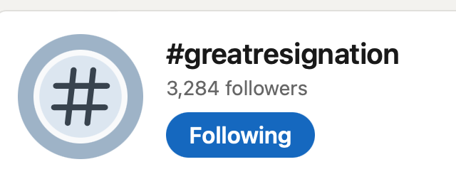
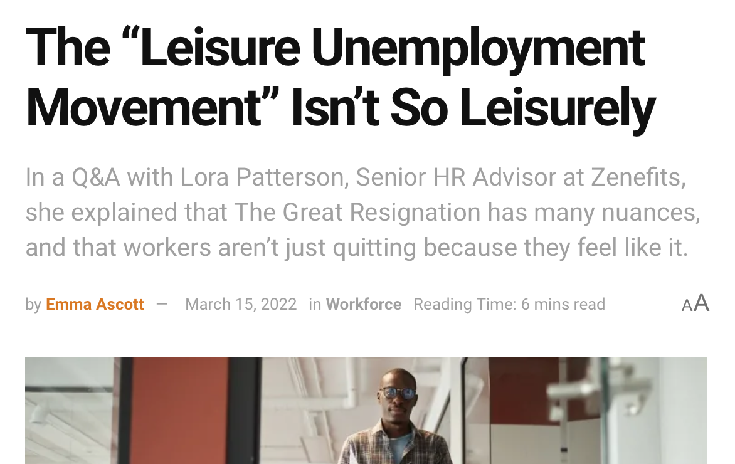
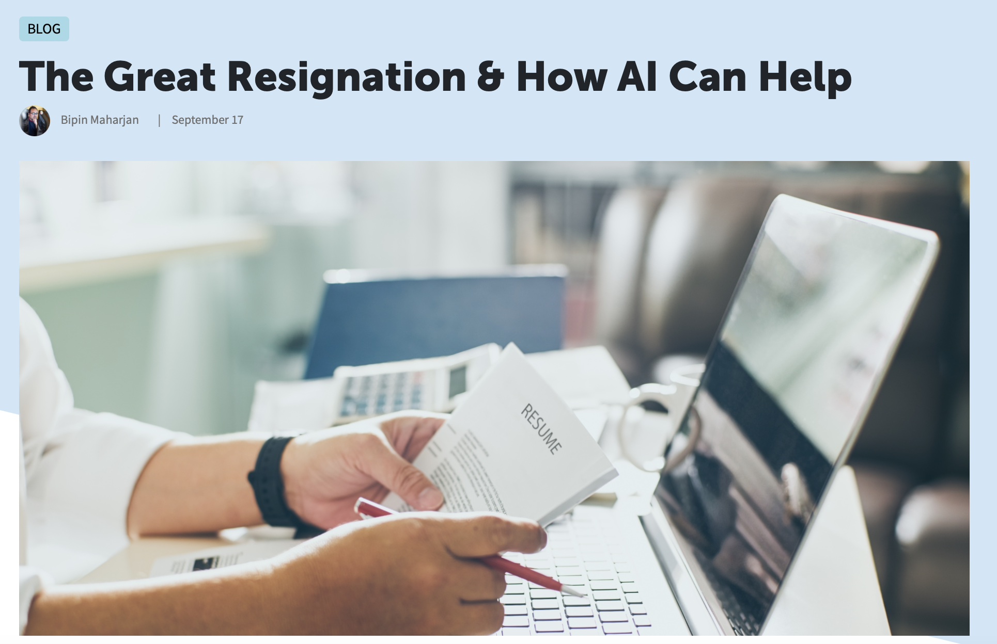
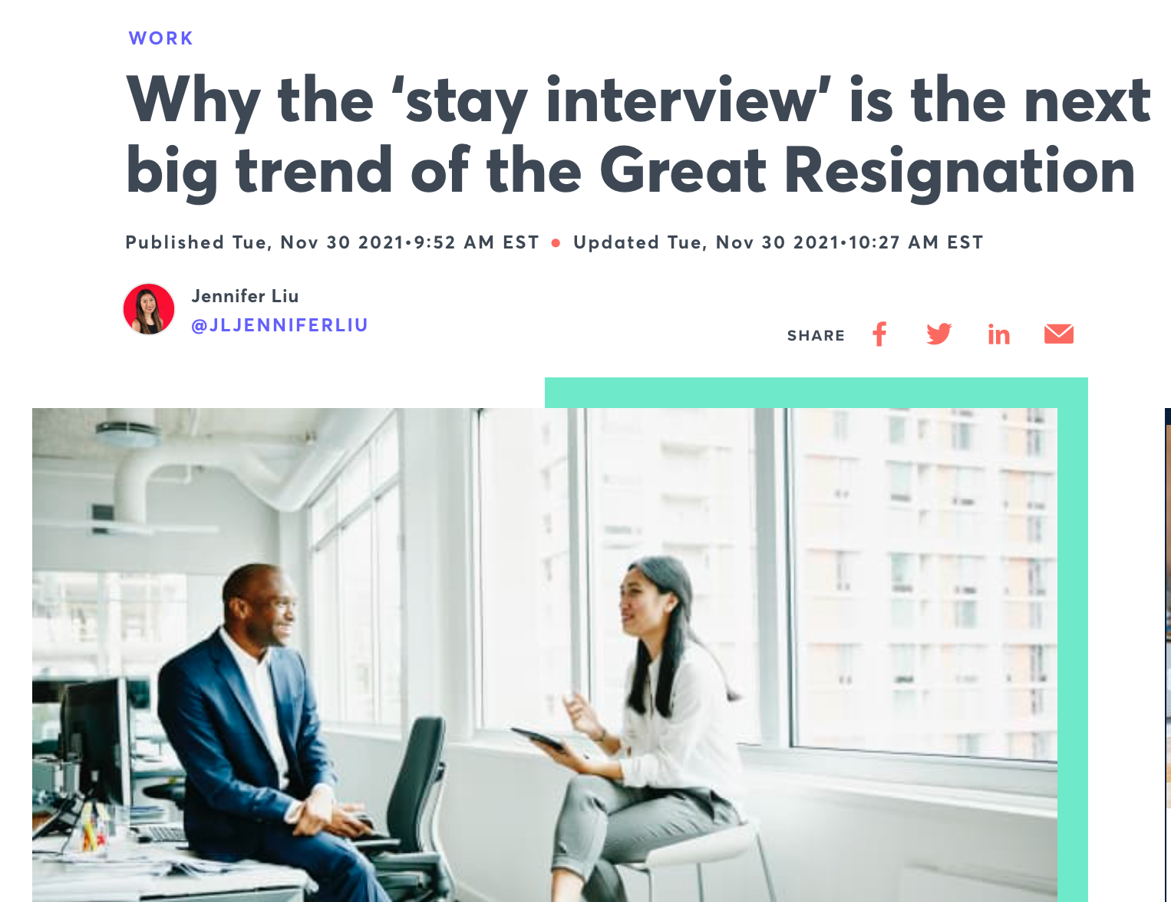

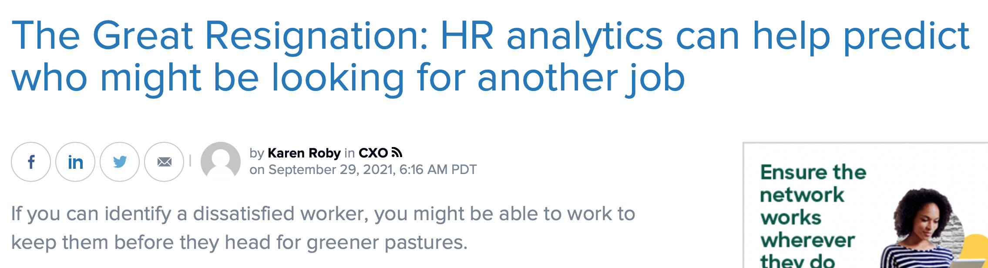
THE ‘FACTS’ OF THE MATTER
COVID-19 CHANGED WORKPLACE CULTURE
FOCUS SHIFTED FROM CHOICE TO CIRCUMSTANCE
EMPLOYERS NEED INSIGHTS TO DRIVE SOLUTIONS
Notes:
- COVID-19 changed workplace culture
- Focus shifted from choice to circumstance
- Employers need insights to drive solutions
Covid-19
- Since the start of the pandemic, the Great Resignation has been discussed by news outlets, on social media, amongst coworkers and between family and friends.
Feeling the shift
- A lot of early conversations detailing record breaking shifts in employment trends portrayed employees that didn't want to work and instead opted to leave for higher pay, remote work or schedule flexibility amongst other drivers.
- Then, conversations started to focus on reasons why employees couldn't afford to tolerate the old norms - whether it was changes in school/childcare, health reasons or inflation.
Changing the narrative
- Companies also had a hard time filling vacant positions due to the high volume of opportunities available and low number of candidates to fill them.
- Companies started to research this phenomenon and focus on ways to attract and retain better talent.
Transition to next slide: we wanted to investigate this event to compare emerging trends in quantitative data from labor force statistics to compare it with sentiment analysis derived from web scraping social media to get to the root of why employees are making these decisions so employers can build out more effective retention strategies.

Slide 4
INTRODUCING THE DATASETS
Bureau of Labor and Statistics
Twitter
Wanted to determine if industry trends correlated with increased separations
Description of the data
Ten Industry Categories Identified
Nine Variables of Interest
Pulled monthly averages of each variable from 2010- Q3 2021
Wanted to determine if shared sentiments across job seekers explained some of the observed shifts
Scraped 44,668 tweets for key words
Great Resignation Resignation
Leaving jobs Toxic job
People quitting Quit my job
Notes:
BLSI:
Ten industry categories all states and the District of Columbia:
Construction
Education and Health Services
Financial Activities
Information
Leisure and Hospitality
Manufacturing
Professional and business
Trade, transportation and utilities
Natural Resources and Mining
Other services (except public administration)
Variables:
unemployment rate
job openings
Hires
Separations
retirement benefits
health care
paid vacation
paid sick leave
total compensations across several industry categories
The way the data is currently formatted online is not conducive to our methods of analysis so we will reformat the data into a usable format in Excel during our cleaning process.
Decided to take annual averages because some were reported monthly or quarterly as numeric values
Be sure to define separations and be prepared with definitions of each industry and variable
Twitter:
Twitter is a global platform with 396.5 million users, 206 million of which access the platform once per day. While only 25% of Twitter users are based in the US, 96% of these users access the platform monthly and spend an average of 158.2 minutes per month on the app (source). Thus, this platform provides significant insight into the conversations and sentiments of professionals regarding their relationship with their employer, employment status, resignation, hiring and the effects of the Great Resignation (GR). We will use these to provide qualitative information on the impact of this phenomenon through use of the Twitter features described in more detail below - Tweets, Users, Spaces and Polls.
The output from these tools will produce results from a maximum of 15,000 tweets, thus the number of columns, rows and size is dependent upon the search criteria.

Slide 5



DATA ANALYSIS METHODOLOGY
1. Explored the data available through BLSI.
2. Selected time series, variables of interest and agreed on industry analysis.
3. Took annual averages of each variable with available data.
1. Initial analysis to compare time series trends of each variable and compare across industries.
2. Ran correlation coefficient analysis to see if any variables were strongly correlated.
1. Scraped on Twitter using Tweepy and Pandas packages.
2. Exported the tweets to Pandas dataframe, then to Excel.
3. Cleaned Excel file and uploaded as Text file to MonkeyLearn.
Dataset Cleaning
EDA
Web Scraping
Notes:
Possible additional explanations:
Did we have null values and how did we account for them?
Why/how did we select the variables we were interested in?
Group question:
- Should we set up correlation analysis of each variable just against unemployment rate since that’s what we really want to see? Or is this painting us too much into a bos?

Slide 6
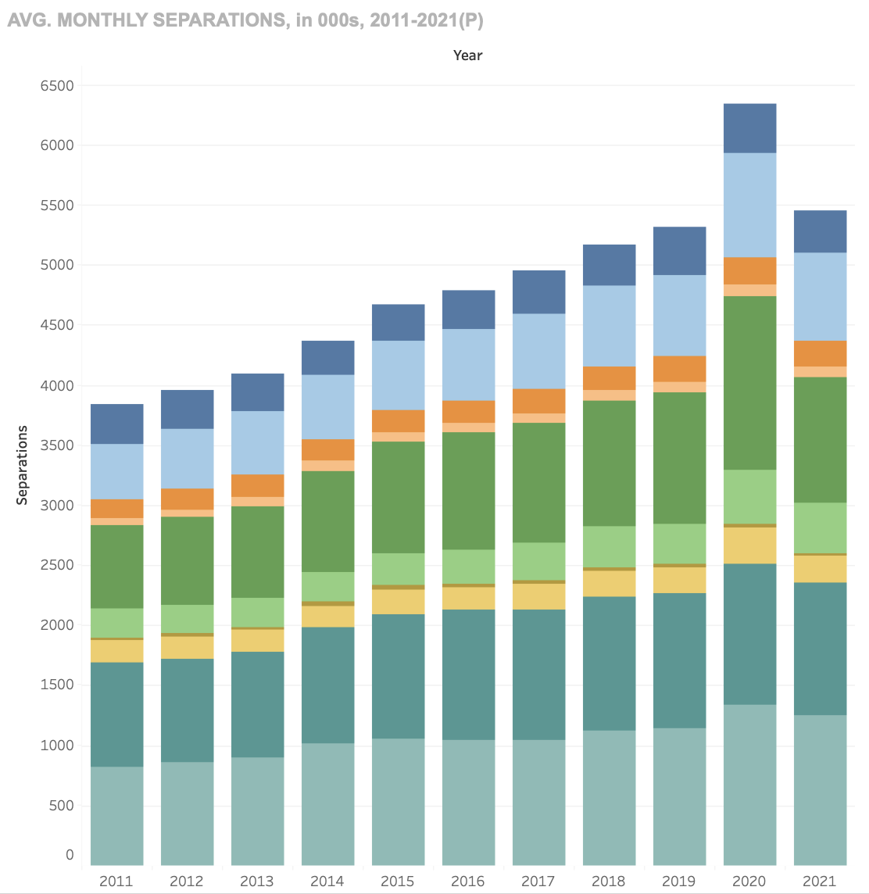
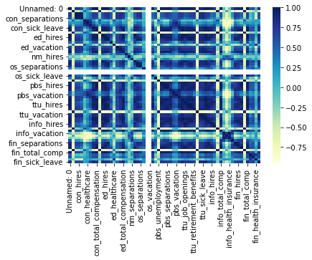
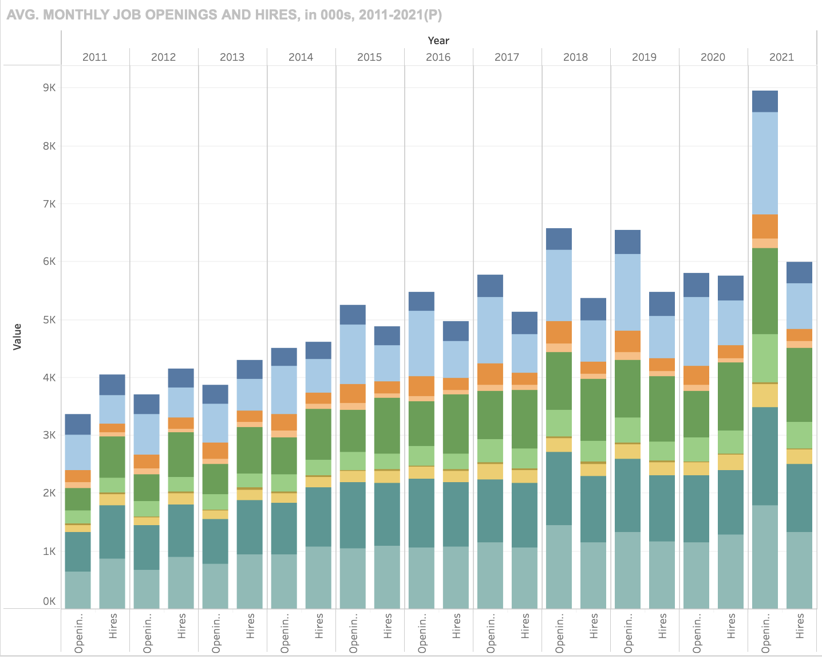
DATA DASHBOARD AND RESULTS
Average monthly separations
The Leisure & Hospitality and Trade, Transportation, and Utilities industries account for the largest proportions of job turnover in the U.S. workforce.
Average monthly job openings and hires
The rate of job openings have historically outpaced hires. 2021 displayed the largest discrepancies between openings and hires, indicating high demand for employees but low supply.
Correlation between job turnover and employment benefits
The strength of correlation between job turnover and employment benefits (e.g., retirement plan, PTO) varies across industries
Live Dashboard
Notes:
Description of dashboard:
Tableau Public was leveraged to summarize and visualize key data and insights gathered during the exploratory phase
Charts were made interactive to enable viewers to specify the granularity and category of information they are seeking

Slide 7
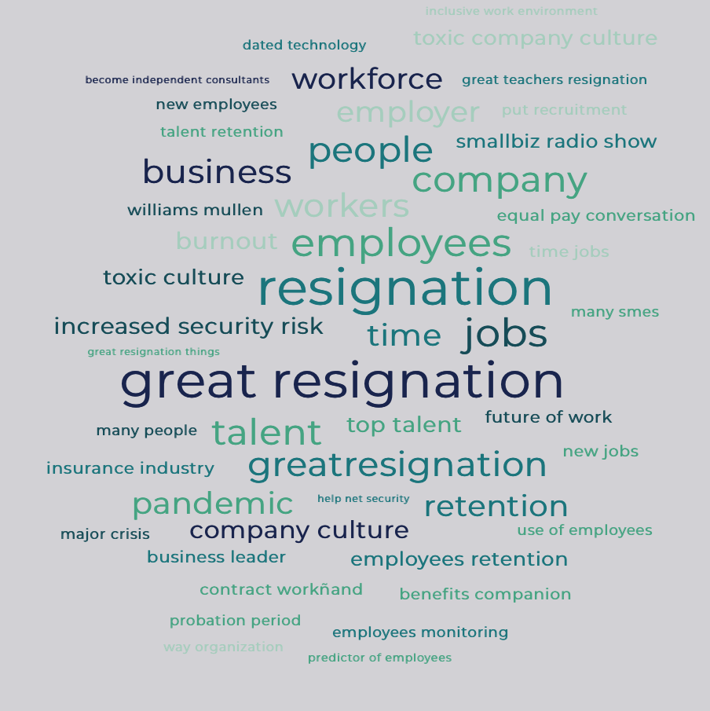
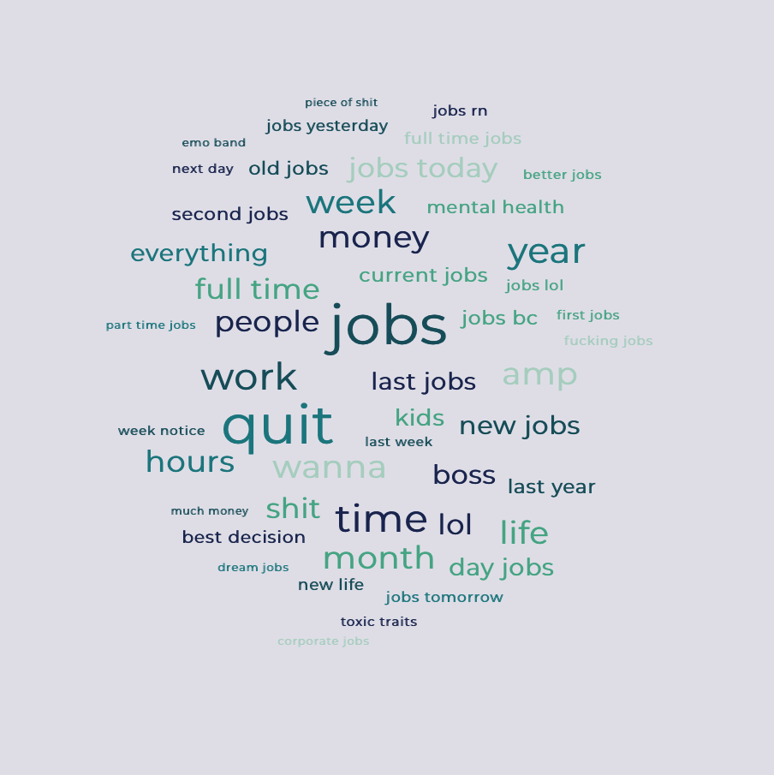
TWITTER WEB SCRAPING ANALYSIS
Scraped 44,668 tweets with the following analysis breakdown
Resignation - 25,262 tweets
Quit my job - 9,762 tweets
Great Resignation - 4,811 tweets
Toxic job - 1,861 tweets
People quitting - 1,574 tweets
Leaving jobs - 1,398 tweets
While we do see some similarities in references like equal pay and benefit companion, we also see references that allude to employee experiences from toxic culture, toxic traits, kids, hours and mental health.
Other industries like teachers and insurance are also mentioned.
Notes:
To enrich the quality of analysis, the team considered including additional non-traditional, non-structured data mainly from Twitter with the hope of adding LinkedIn in the future
The APIs considered included:
LinkedIn APIs ;
Twitter APIs;
The initial web scraping was carried out with Twitter using Pandas and Tweepy packages scraping the conversations with the key words “ the great resignation” and “quit my job”.
Exported the results from “Great Resignation” and “quit my job” into Excel, cleaned and imported to MonkeyLearn to view as word cloud
Challenges and next steps:
- The ‘great resignation’ phenomenon was coined only 2 years ago, the team will eventually limit the analysis involving webscraping results to that period where else the main data set is between 2010-2021
- The team did not have adequate time to scrape through LinkedIn \\to provide meaningful data to complement the structured data
- LinkedIn API may provide better source of data because it is is more structured as the layout is

Slide 8
NEXT STEPS IN DATA ANALYSIS
More data!
Web scraping other platforms
Statistical analysis
Prediction/Optimization model
Notes:
Additional datasets
Go back further in time to observe other times when employment was affected (2008 Recession) and make it more granular (look on a monthly or quarterly level)
Pull in finalized 2021 data since some datasets stopped in Q3 2021
Web scraping
Completing sentiment analysis of Twitter data
Repeat process with other platforms prioritizing LinkedIn, but can also do Reddit and Facebook
Prediction/optimization model
Building and testing a prediction/optimization model for HR teams can use to design targeted solutions for ideal work environments without compromising the bottom line
Statistical analysis
to see if there is a significant difference in the number of job losses and openings in Trade & Hospitality vs other industries

Slide 9



FUTURE IMPLICATIONS
EMPLOYERS HAVE MORE URGENCY AROUND IMPROVING EMPLOYEE EXPERIENCE, COMPANY CULTURE AND ONBOARDING EFFICIENCY.
ADJUST COMPENSATION PRACTICES, CULTURAL NORMS AND BENEFITS ACCORDINGLY
INCORPORATE MORE PROACTIVE EMPLOYEE RETENTION POLICIES INCLUDING MORE FREQUENT, SAFE AVENUES FOR EMPLOYEE FEEDBACK

